Slide 1



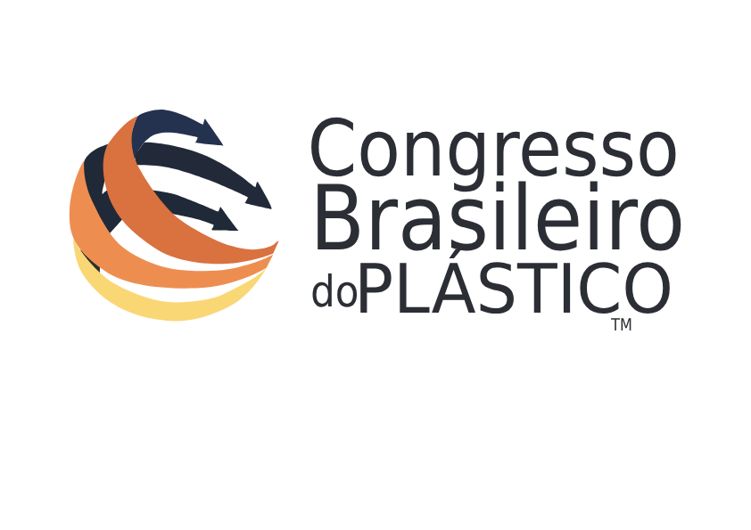
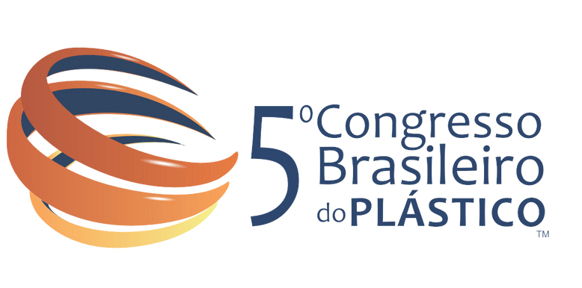
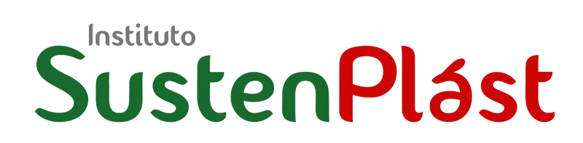
Larissa Ogera D'otaviano
Larissa Ogera D'otaviano
Innovation and Sustainability
in Plastic Circularity
LARISSA OGERA D'OTAVIANO
Realização:

Slide 2
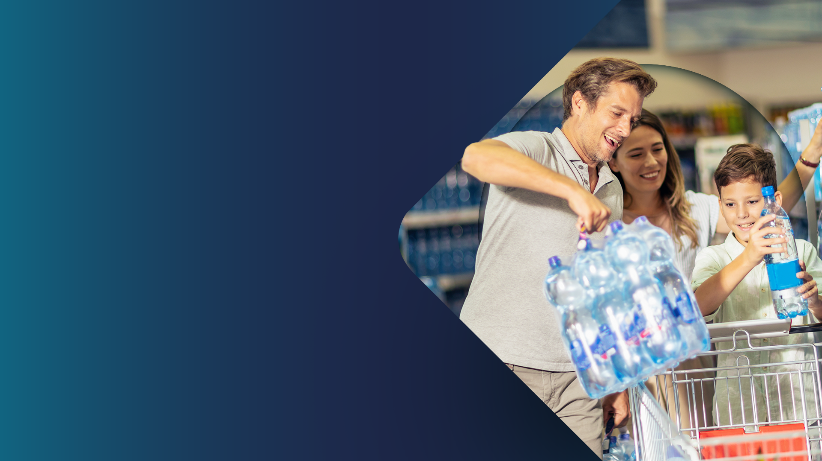


For over 45 years in the market,
Valgroup has become a reference in the production, transformation and recycling of plastic.
The company's purpose is to improve society's quality of life through innovative and sustainable packaging solutions.

Slide 3
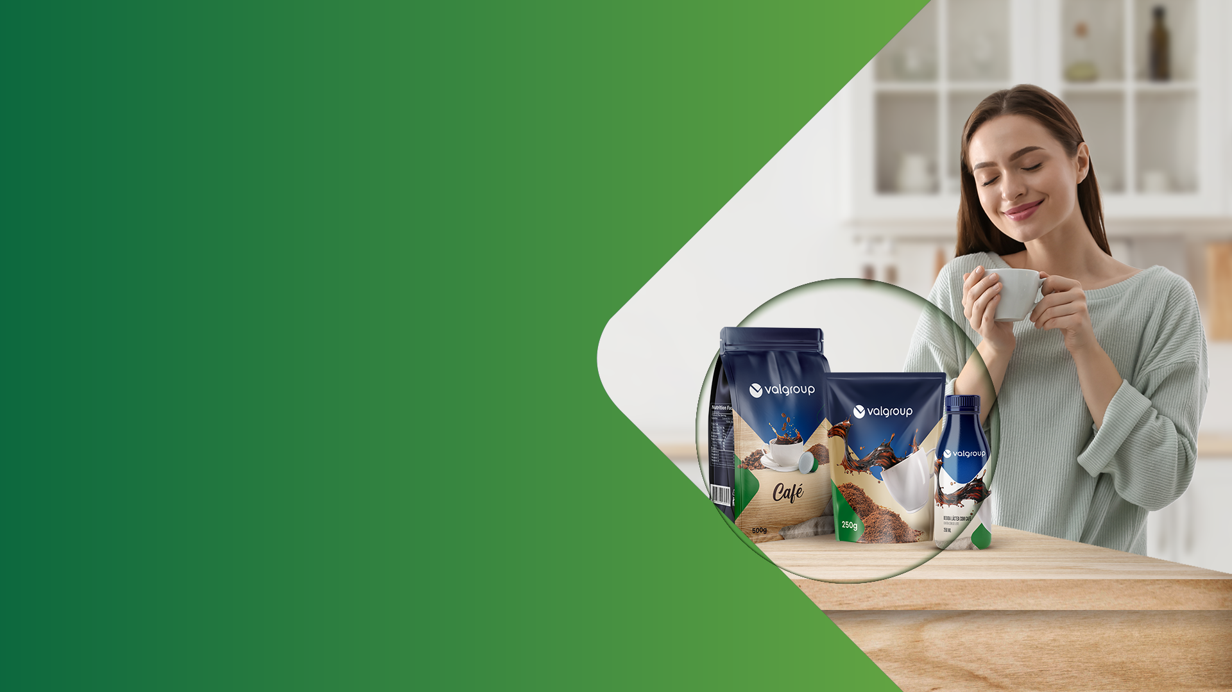
Values ​​that
TRANSFORM
Sustainability is part of
our DNA and we will lead the transformation of our industry
towards a sustainable industry.
Our search for Innovation never stops. We innovate in products, processes, equipment and services.

Slide 4







About us
+ 7.000 employees
41 production plants
and 7 logistics plants
Operations in 7 countries
Revenue of USD 2.3 billion in 2023

Slide 5


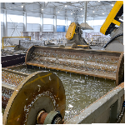
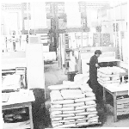
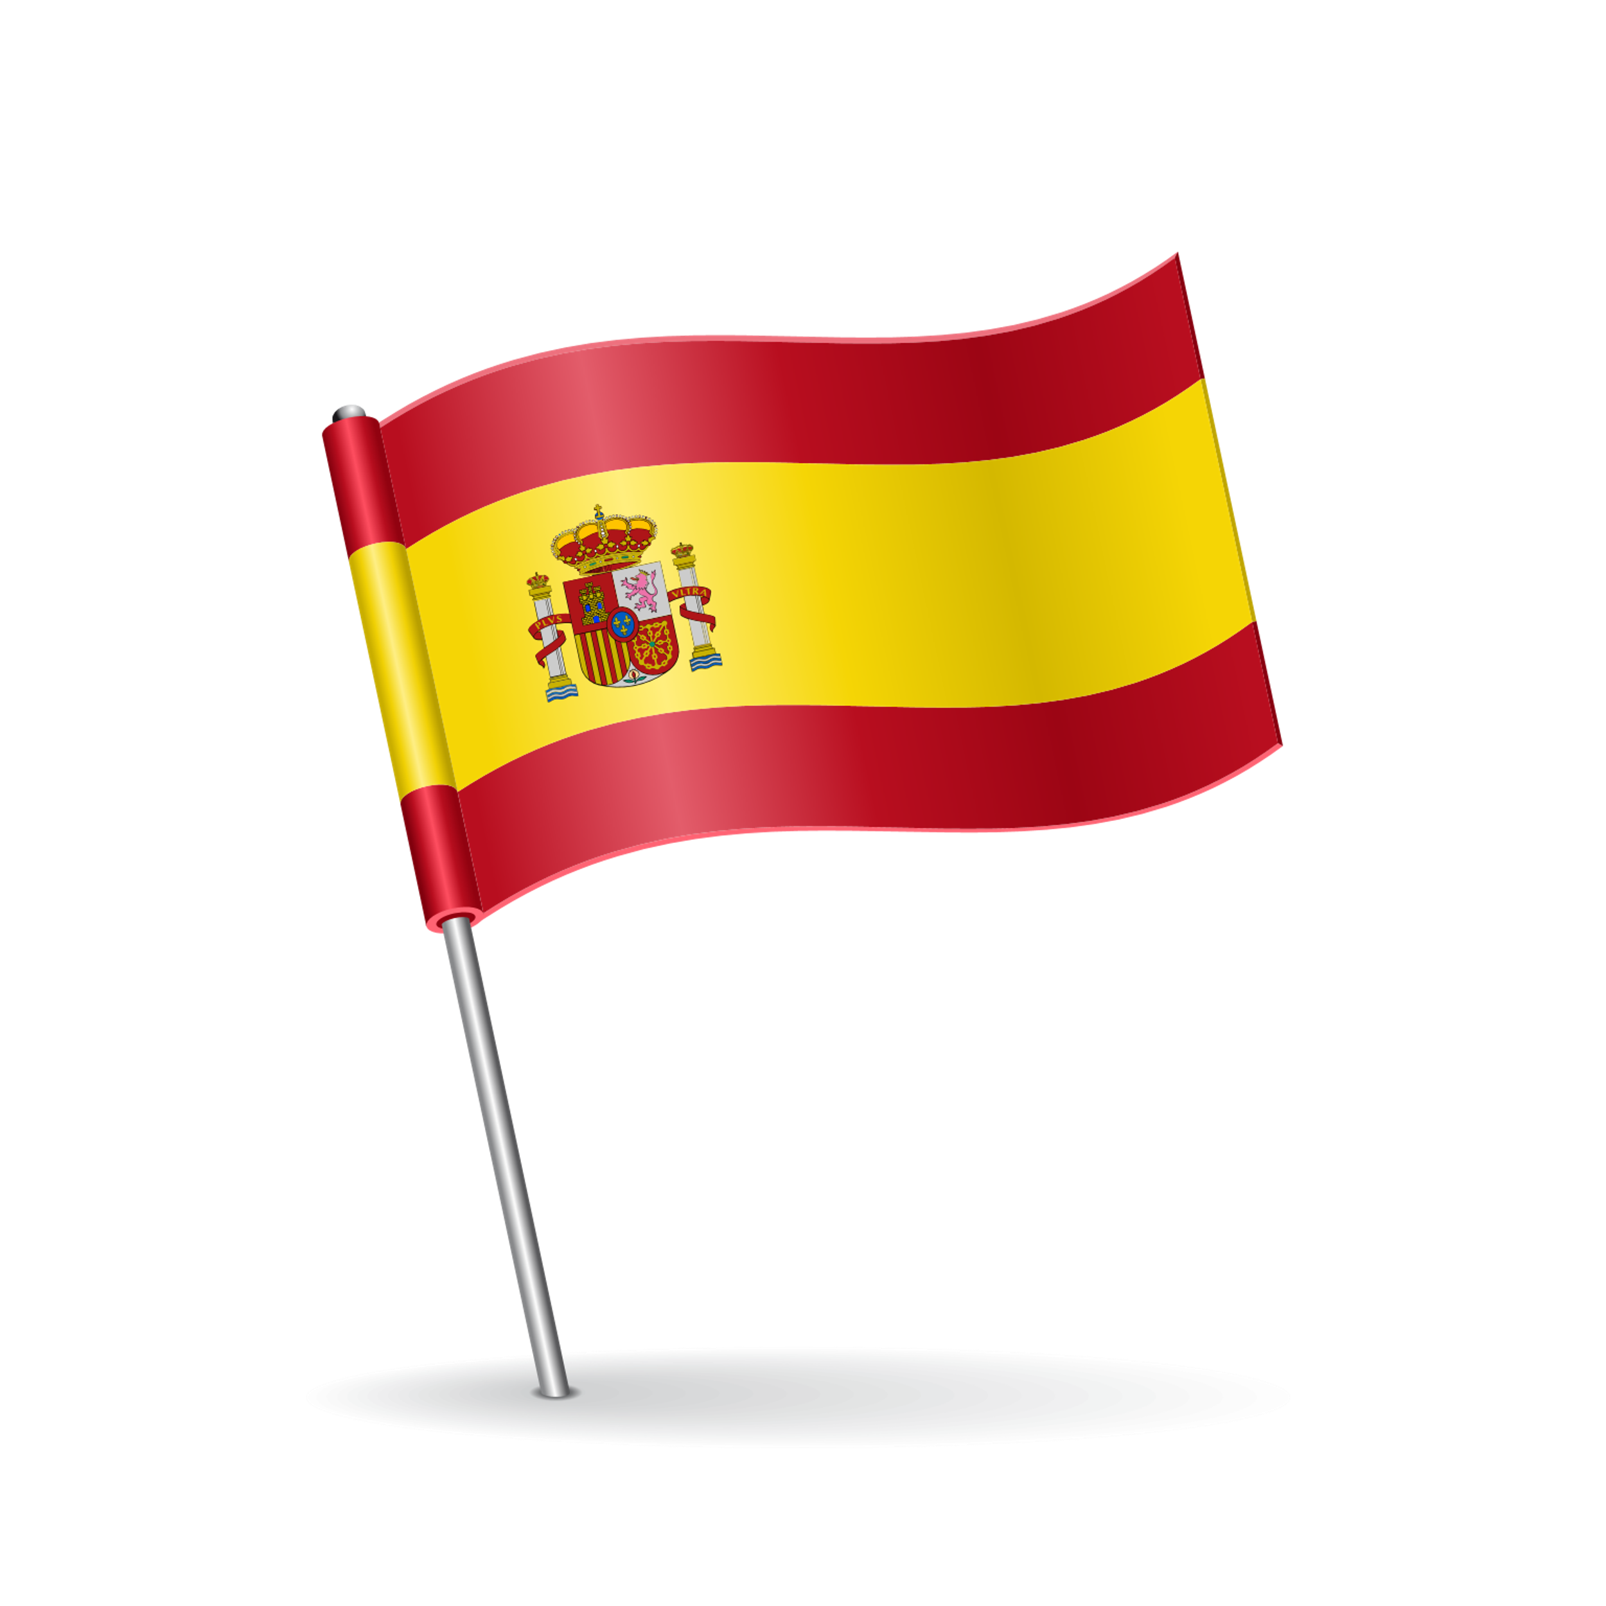
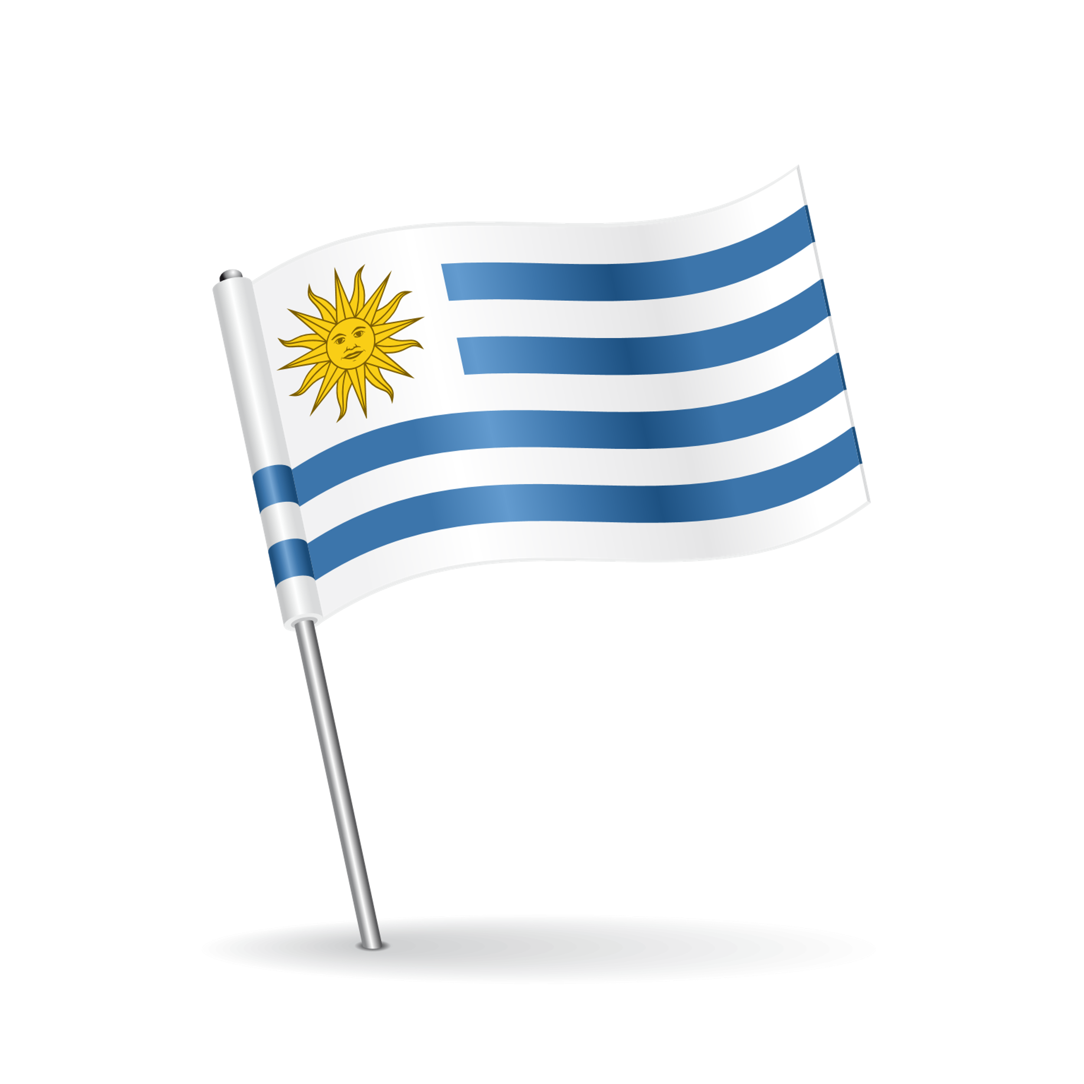
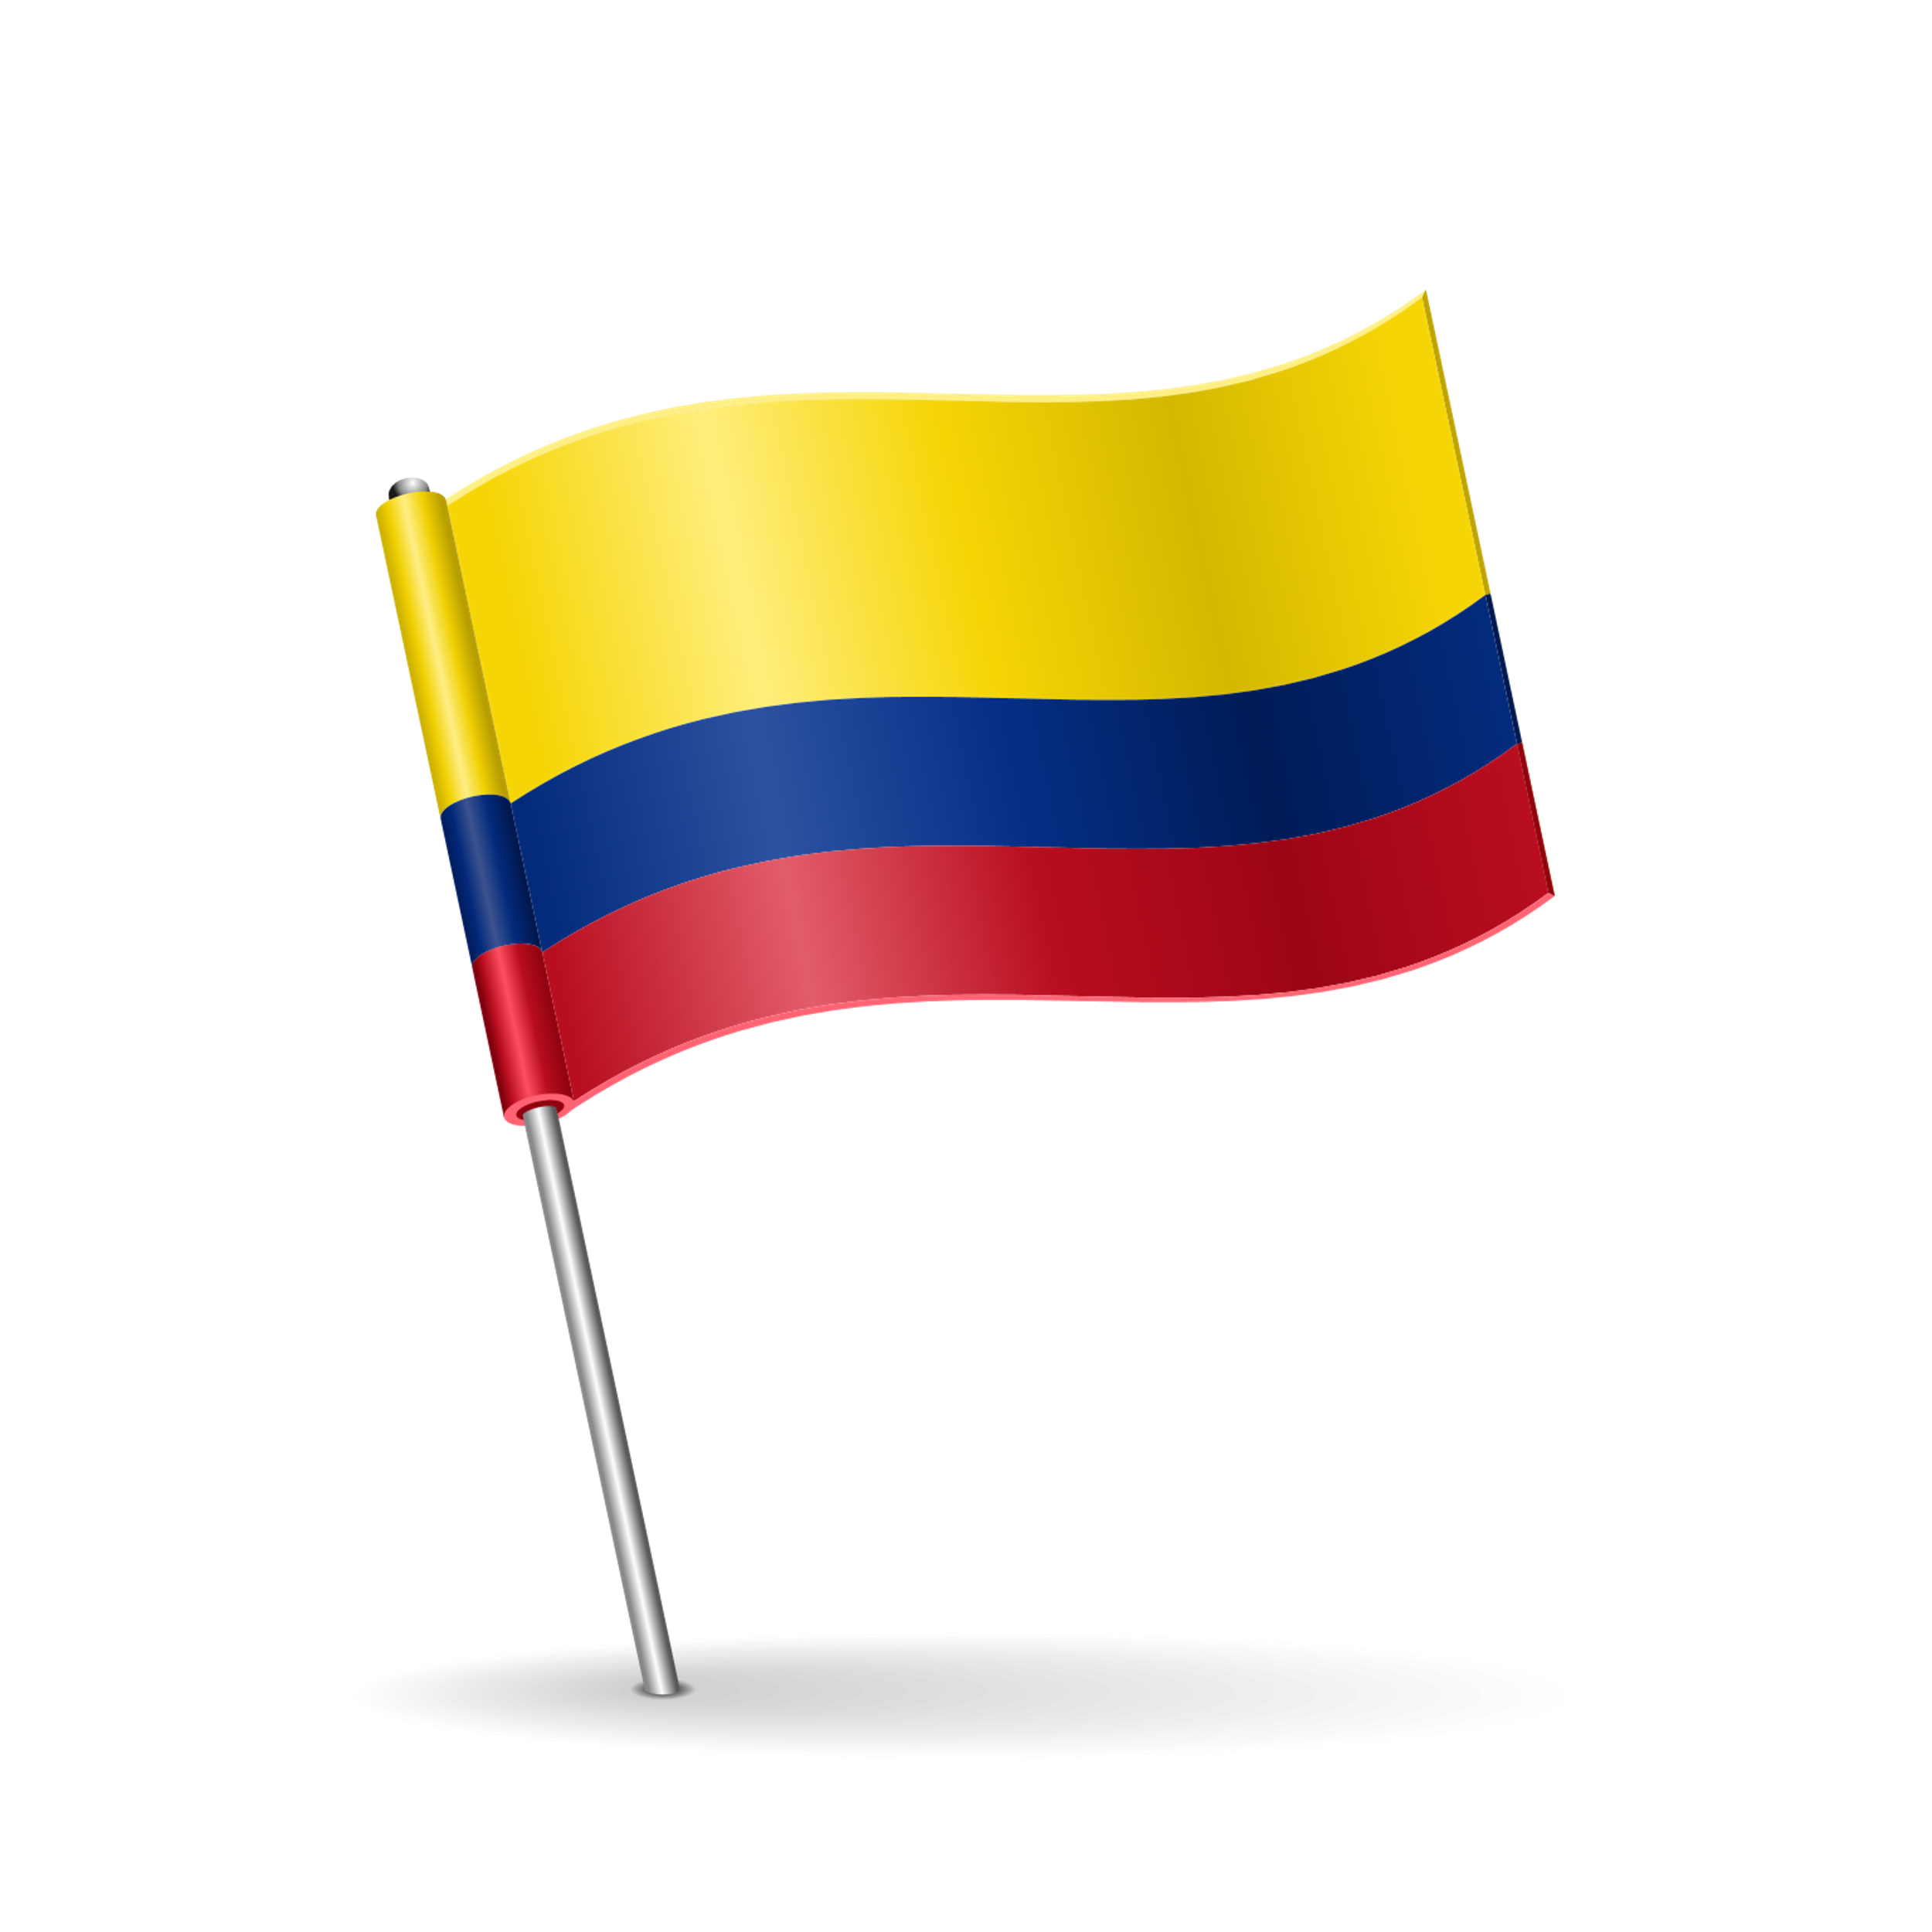
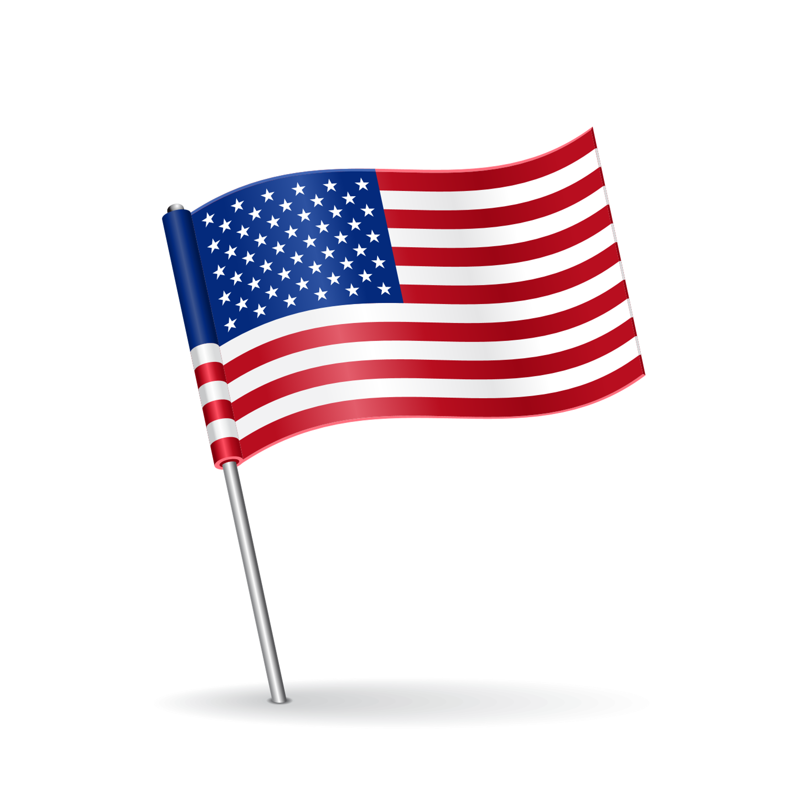

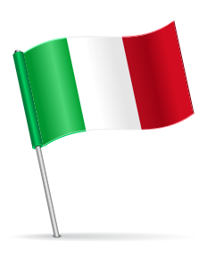

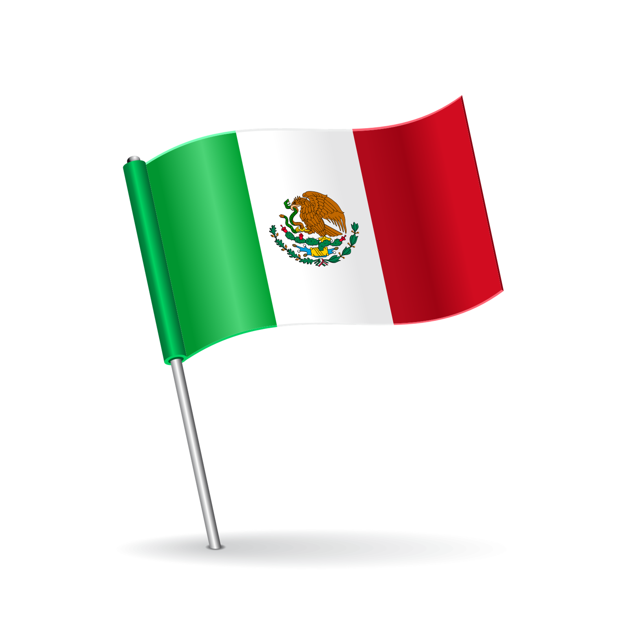


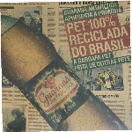
Over 45 years on the road
Packaging for baler and automatic packaging
PET
bottle recycling (Bottle-to-Bottle)
FOUNDATION
PE Recycling
Technical
Films
Laminated Films
Spain
1976
1977
1985
1989
1990
1993
1995
1996
2000
2001
2004
2005
Plastic bags
Films
Shrink
Films
Stretch
Preforms and PET bottles
Barrier Bags
Uruguay
Films
BOPP
Wrapping Machines
Colombia
Caps
Heat shrink bags
USA
PE blowing
New Acquisition
in Italy
2007
2008
2009
2012
2014
2015
2018
2019
2021
2022
2023
2024
Masterbatches
Acquisition
Cabreúva/SP
Mexico
Italy
ANVISA approval for the use of PET PCR
Recycling Expansion –
Recife/PE Plant
Expansion of the
PET preform line in PE
1st PET Bottle using 100% PCR
Acquisition of Poços de
Caldas/MG and Araquari/SC

Slide 6
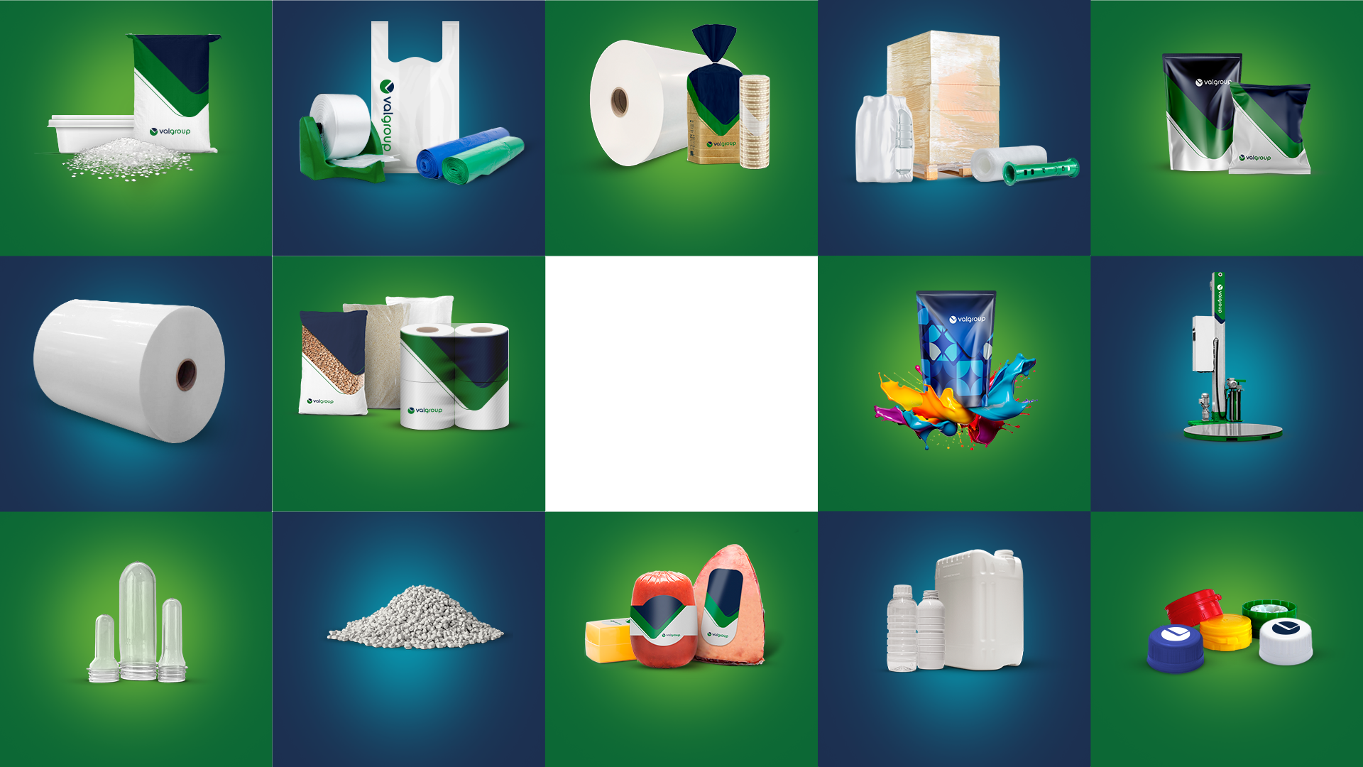
Compounds and Masterbatches
Packaging for retail
BOPP Films
Industrial Films
Laminated
Films
BUSINESS
Divisions
We produce and develop complete, innovative and sustainable solutions
for the market.
HDPE
Technical Films
Plain and Printed
Technical Films
Digital Printing
Machines
Preforms
r-PET
Shrinkable Films
PET/PE blowing
Caps

Slide 7
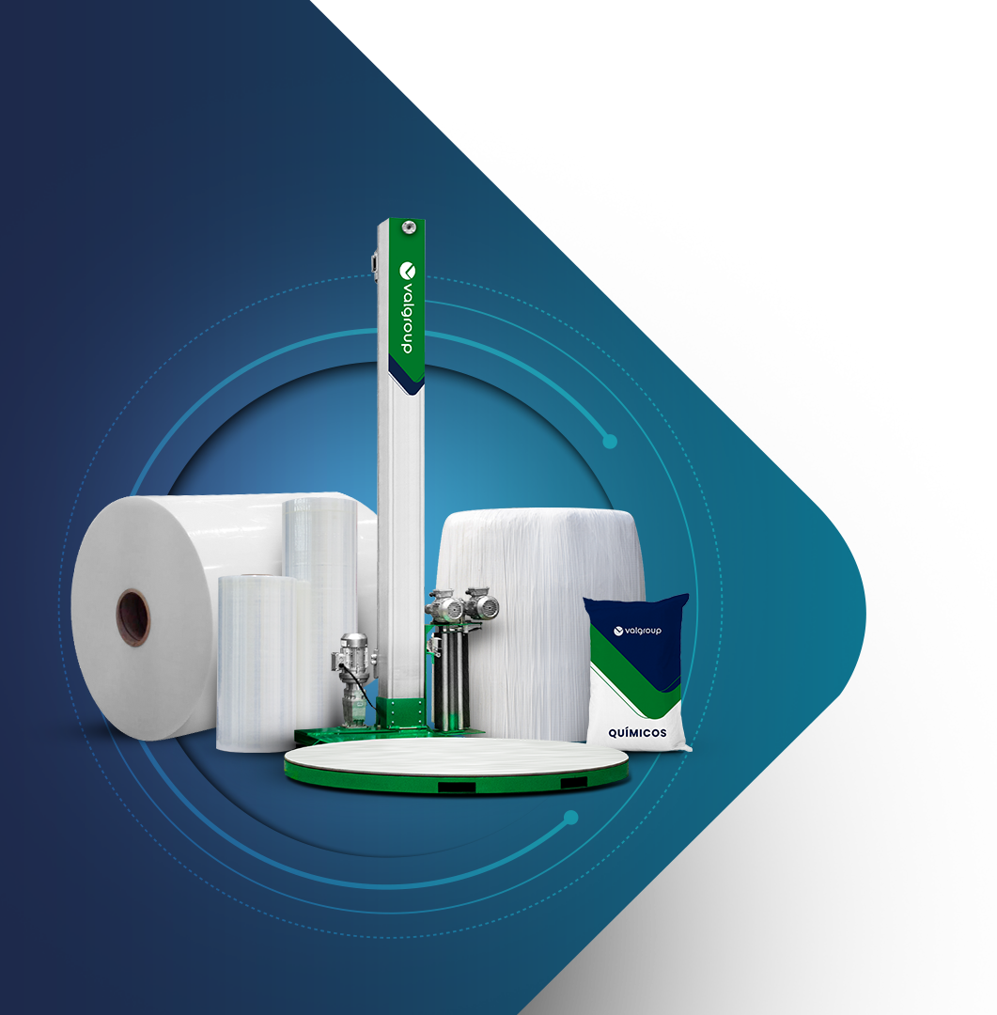

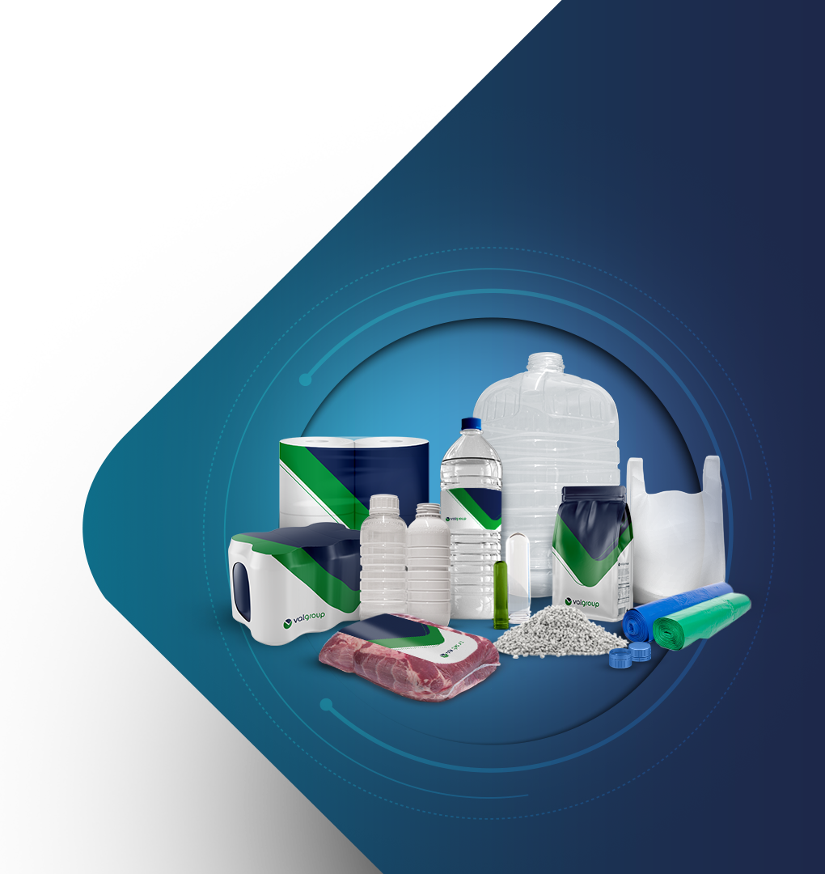




SUSTAINABILITY
Valgroup

Slide 8
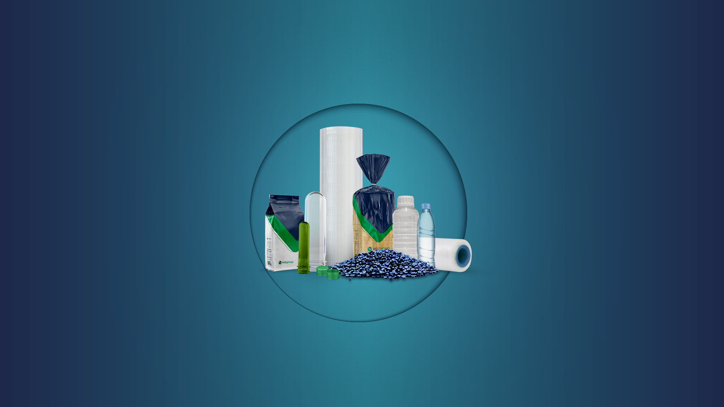

Simplified
structures
?
Why
Broadly designed
for Recycling
PLASTIC
Lower carbon
emissions
when compared to other packaging with the same volume
Lower weight
when compared
to other packaging for the same application
Lightweight, sterilizable
and affordable
Supports Recycled Material
Notes:
Após contar a historia da Valgroup a ideia é mostrar o porque escolhemos o plástico e a importância dele na sociedade. Fiz uma busca das características que nossos concorrentes mais apresentam e que nossos clientes mais valorizam.

Slide 9





REDUCE
REDESIGN
We adopt practices to
reduce resource consumption
in our production processes, from selection
of raw materials to the efficient use of products, minimizing waste.
We prioritize sustainable innovation, redesigning products and processes from
the design phase to make them more efficient and ecologically correct, anticipating environmental challenges.
SUSTAINABILITY
pillars
Valgroup
RECYCLE
REINTEGRATE
We invest in modern recycling processes,
such as Mechanical Recycling
of PET, Flexible and Laminated Films, in addition to Advanced Recycling, to convert waste into new materials, reducing waste and preserving natural resources.
In addition to producing sustainably, we are responsible for the complete life cycle of our products, reintegrating them into the production cycle in a sustainable manner at the end of their useful life.

Slide 10
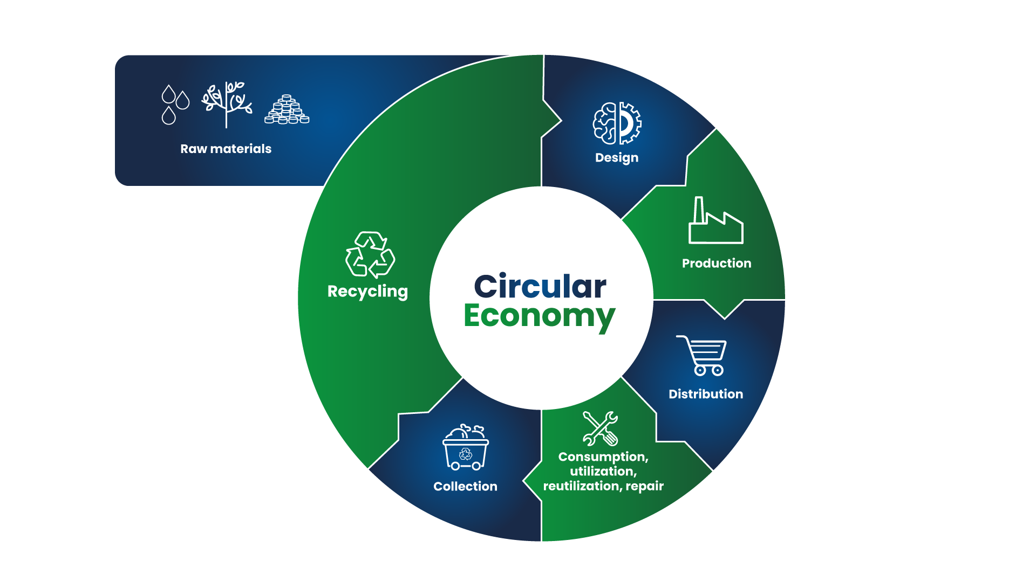

Notes:
Meninas, aqui a minha ideia é colocar exemplos de nossos pouches monocamada e aquela embalagem da nespresso, que ganhamos premio

Slide 11



Recycling Processes
Mechanical Recycling
Films
Since 1976
Mechanical Recycling
PET
Since 2000
Mechanical Recycling
Laminated and Printed Films
Since 2020 (Deink)
Advanced Recycling
All Plastics from 2025
For every ton
of recycled resin produced, we reduce
emissions by 78% compared to virgin resin.
For every ton
of recycled resin produced, we reduce
emissions by 53% compared to virgin resin.
For every ton
of recycled film produced, we reduce
emissions by 83% compared to virgin resin.
For every ton
of recycled plastic produced, we reduce
emissions by 125% compared to virgin resin.
WE STOP EMITTING
1.5 tons of CO2eq/ton
WE STOP EMITTING
1.1 tonCO2eq/ton
WE STOP EMITTING
1.6 tons of CO2eq/ton
WE WILL STOP EMITTING
2.4 tons of CO2eq/ton

Slide 12
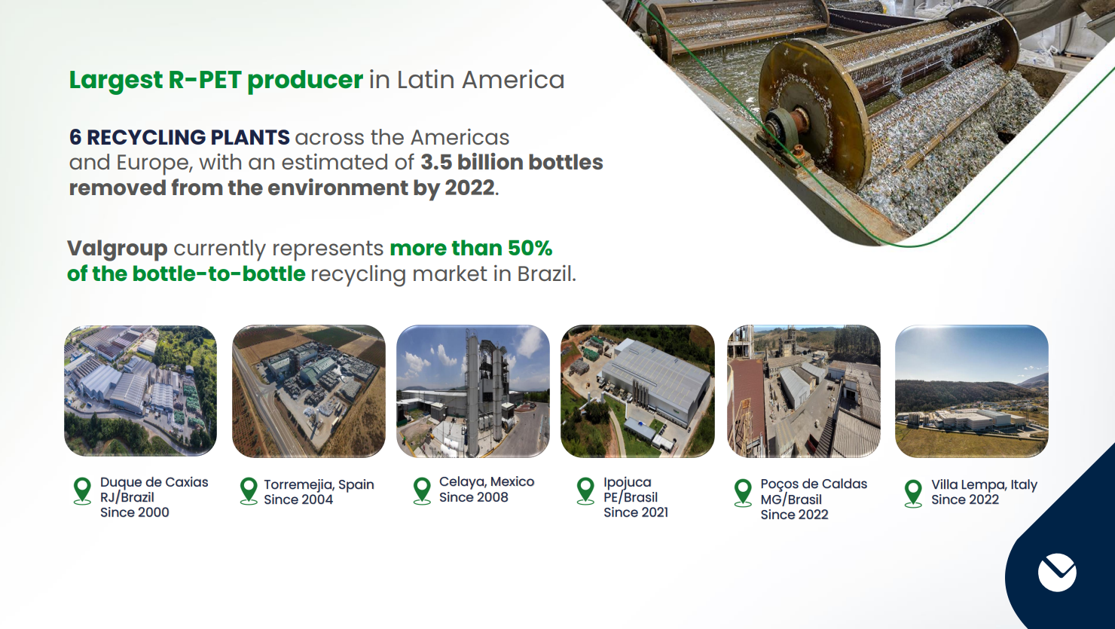

Slide 13
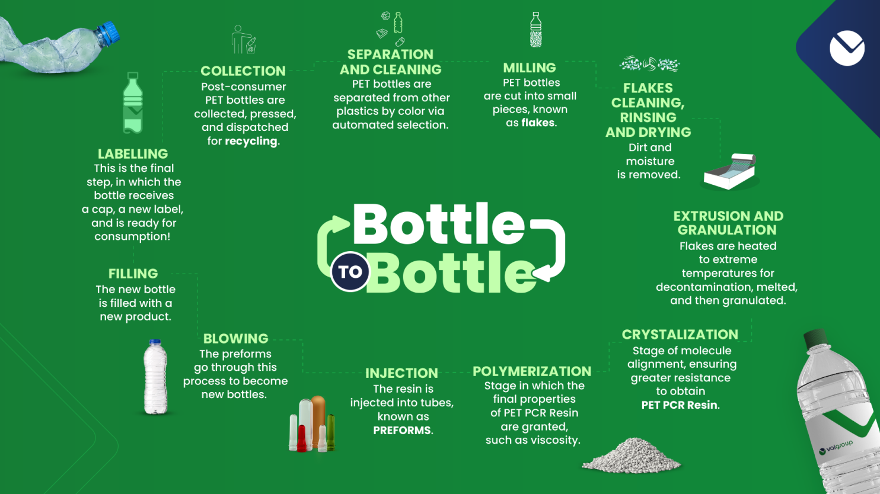

Slide 14

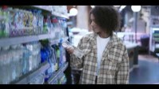
Valgroup PET Recycling

Slide 15
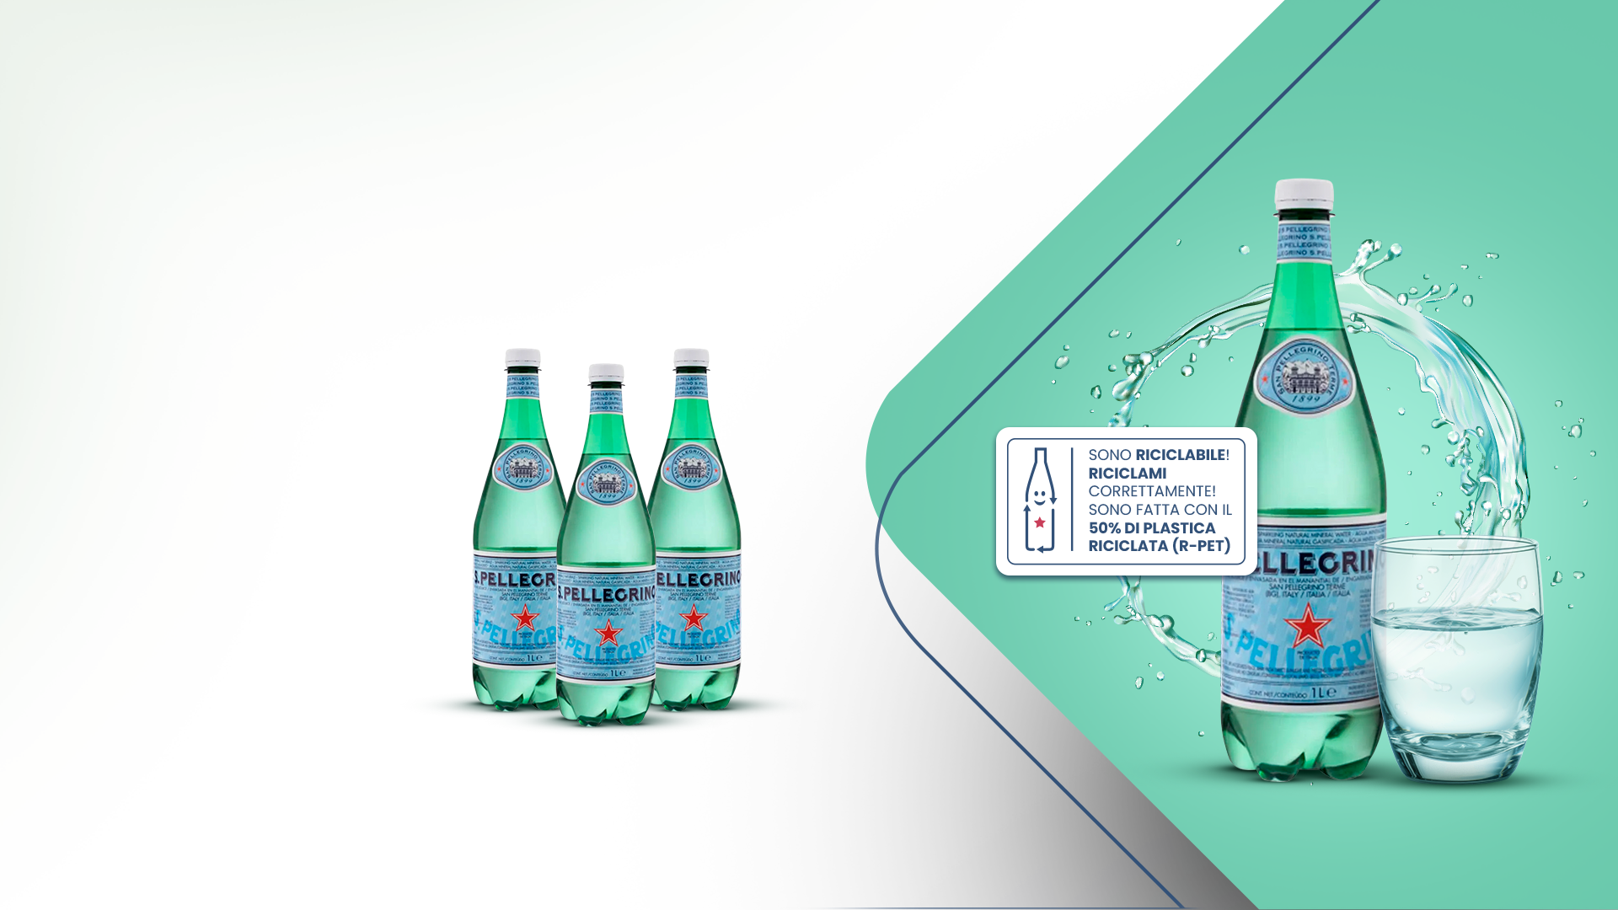
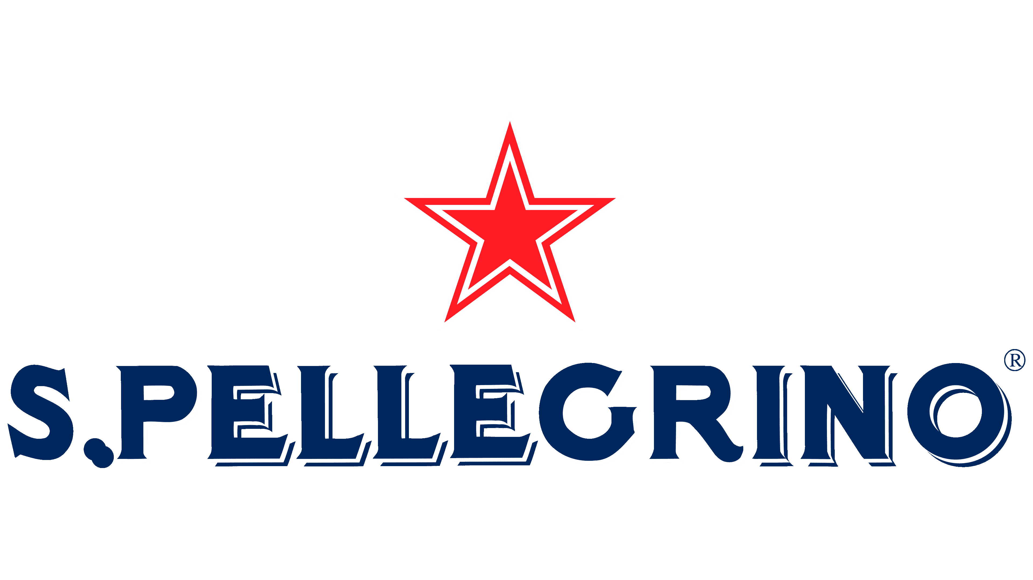

Sustainability
Sucess Case
Developing our own recycling process
for a safe PET recycled content
2024
50%
PET PCR
BOTTLE

Slide 16
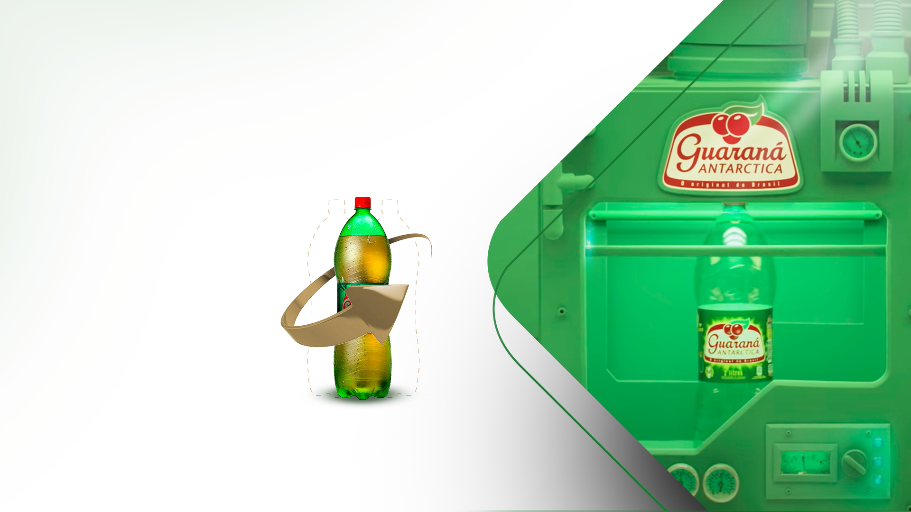
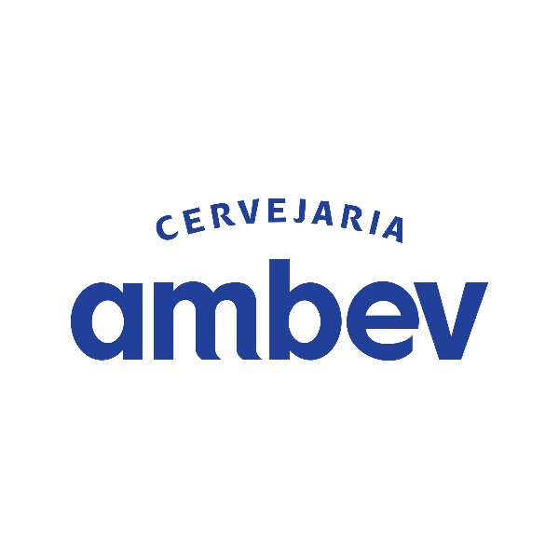
Sustainability
Sucess Case
Developing our own recycling process
for a safe PET recycled content
2012
First 100%
RECICLED PET
in Brazil

Slide 17
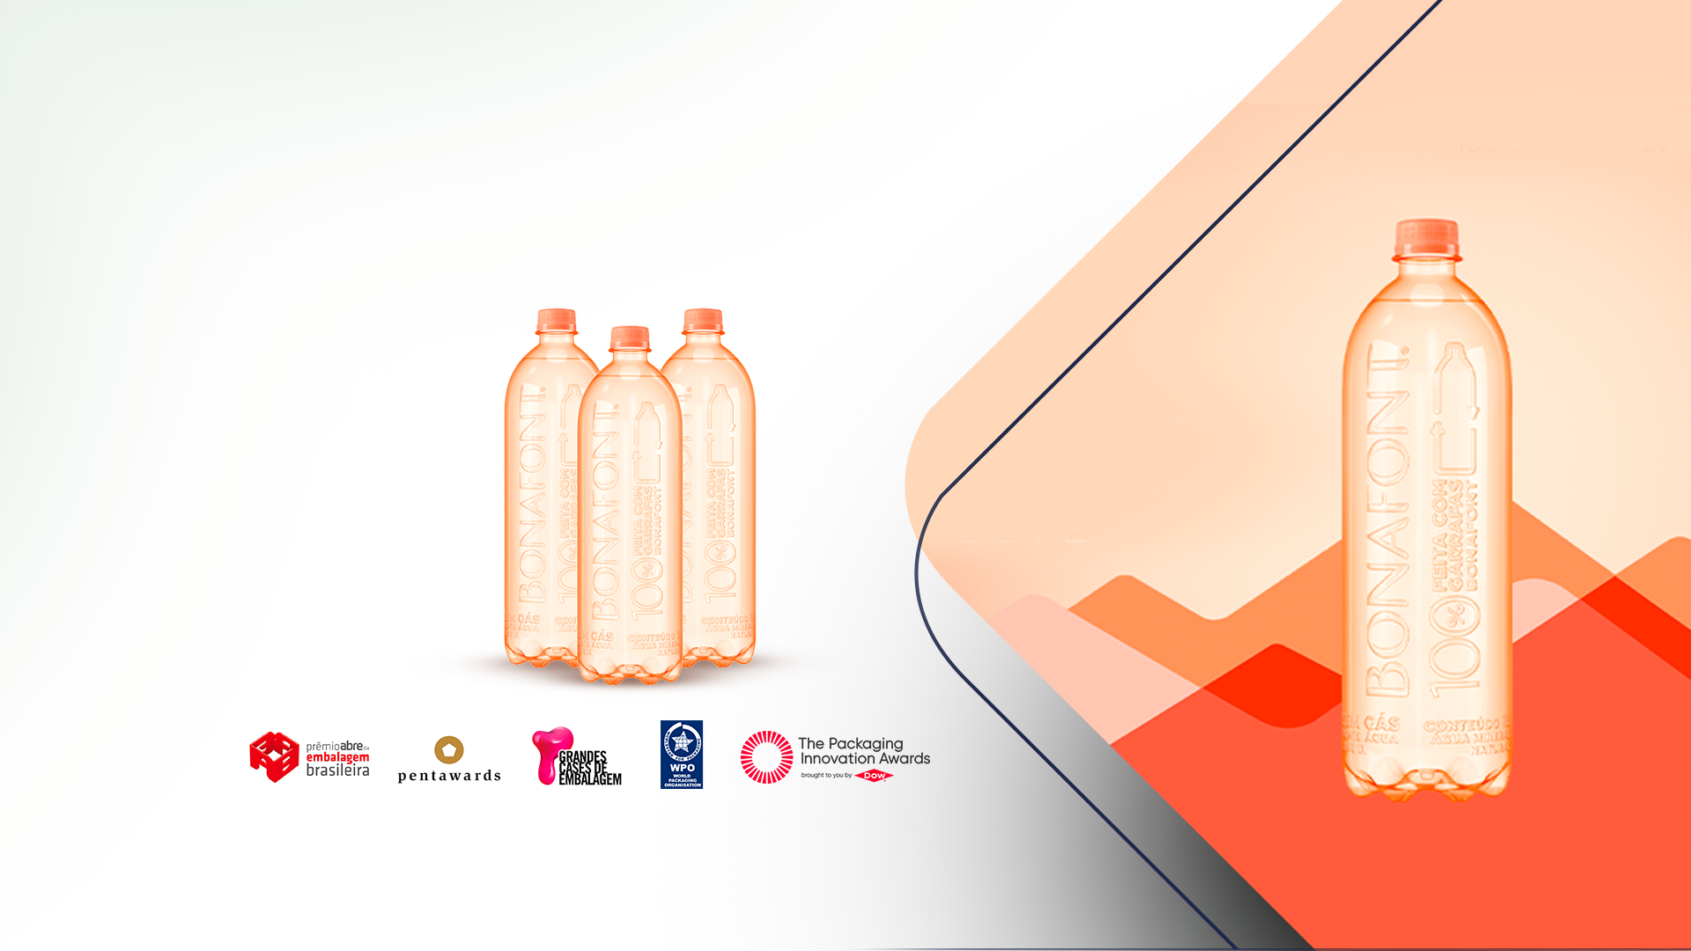

Sustainability
Sucess Case
Developing our own recycling process
for a safe PET recycled content
2022
First
No Label
Bottle in
Brazil
Prêmios:

Slide 18
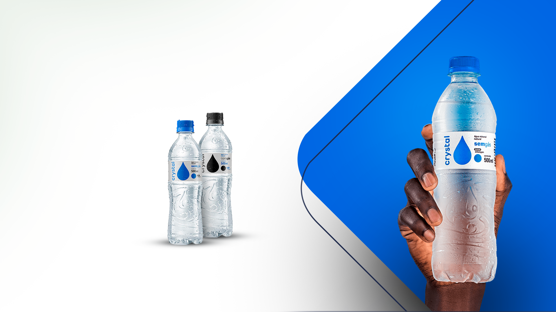

Sustainability
Sucess Case
Developing our own recycling process
for a safe PET recycled content
2020
100% PET
PCR Bottle

Slide 19
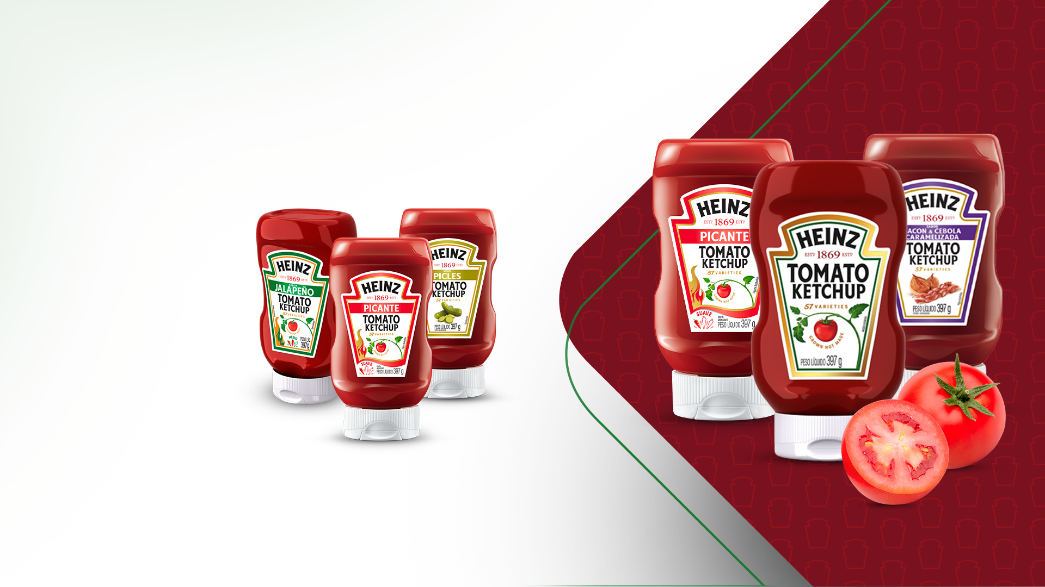
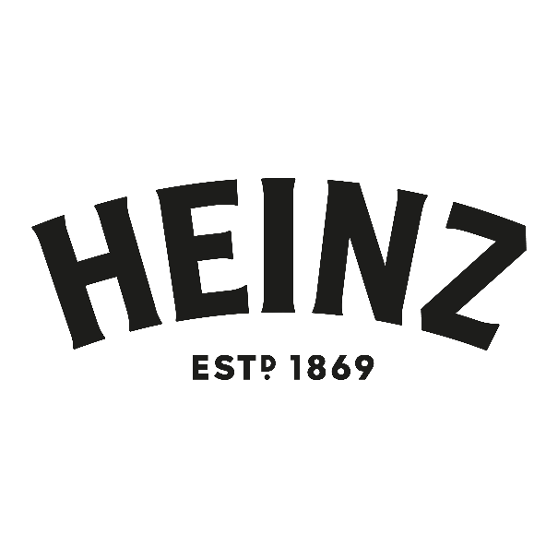
Sustainability
Sucess Case
Developing our own recycling process
for a safe PET recycled content
2022
Pioner in the use of PET PCR in Ketchup bottles
30% of PCR content

Slide 20
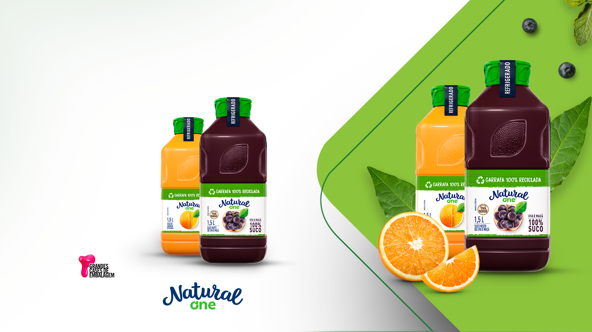
Sustainability
Sucess Case
Developing our own recycling process
for a safe PET recycled content
2022
100% PET
PCR Bottle
Prêmio:

Slide 21
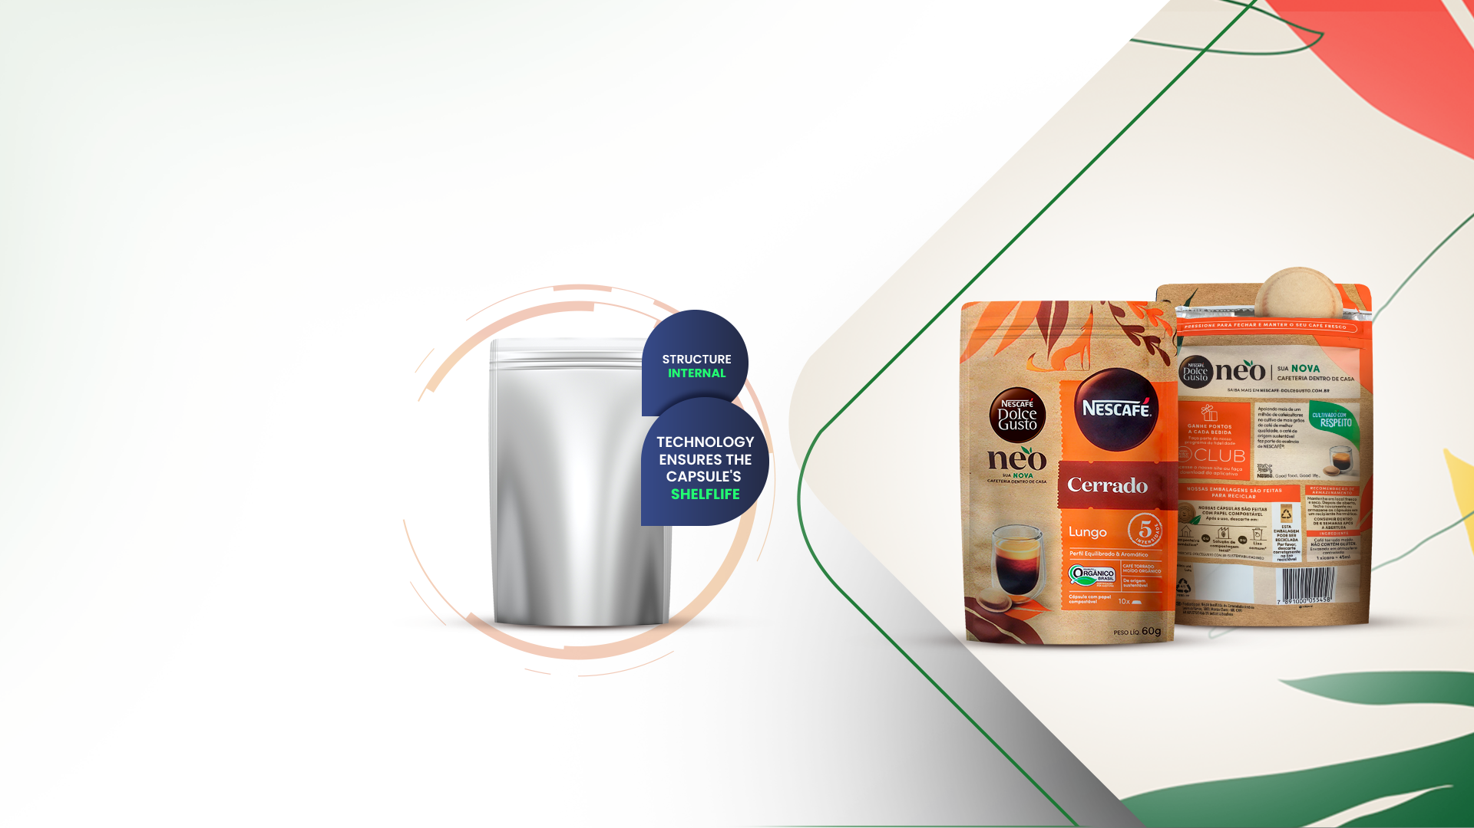
Sustainability
Sucess Case
2022
Stand-up Pouch 100% recyclable with airtightness and high barrier to humidity for compostable capsules

Slide 22
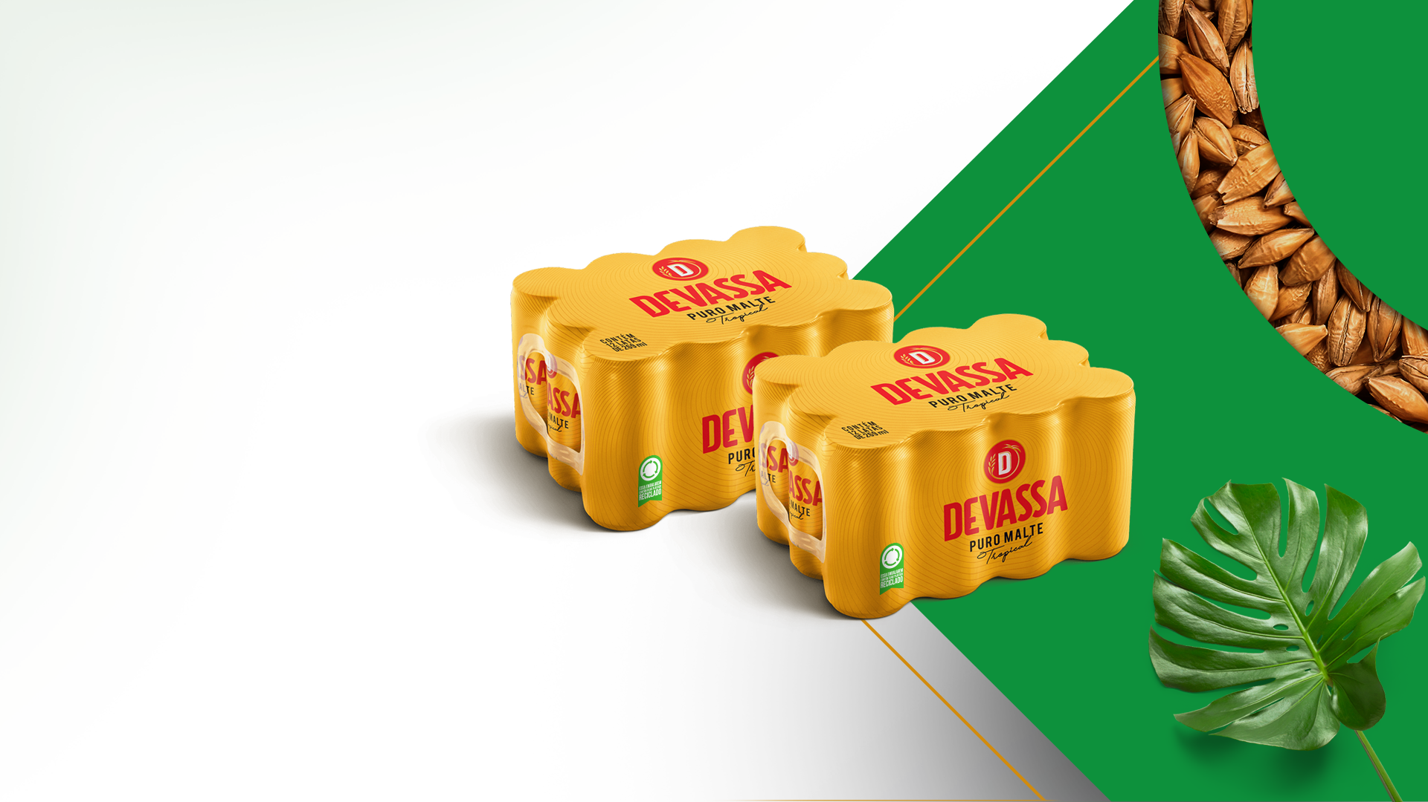
Sustainability
Sucess Case
2022
Shrink film
with 30%
of Recycled
Content

Slide 23
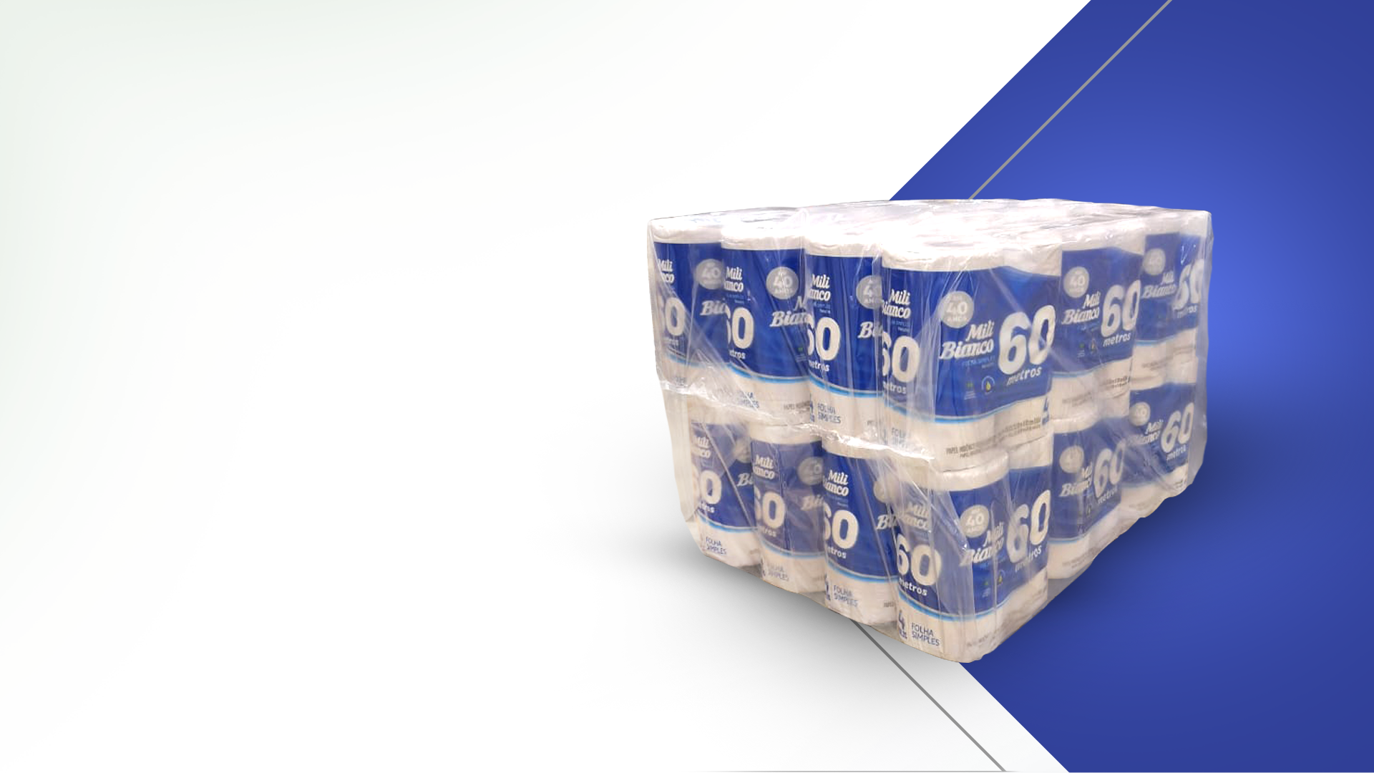
Sustainability
Sucess Case
2022
Baler with
30% Recyled
Content

Slide 24



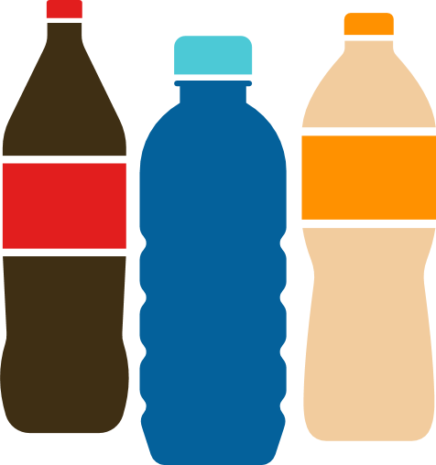







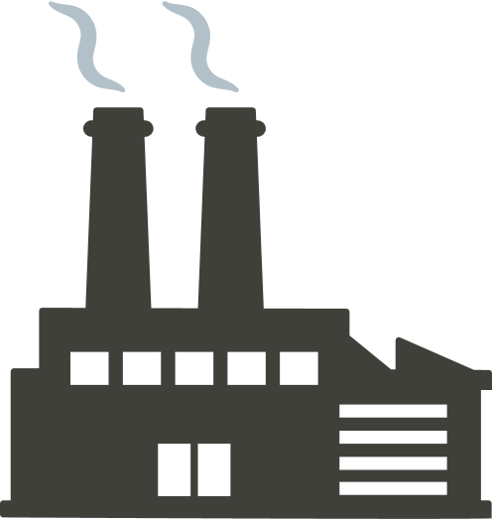
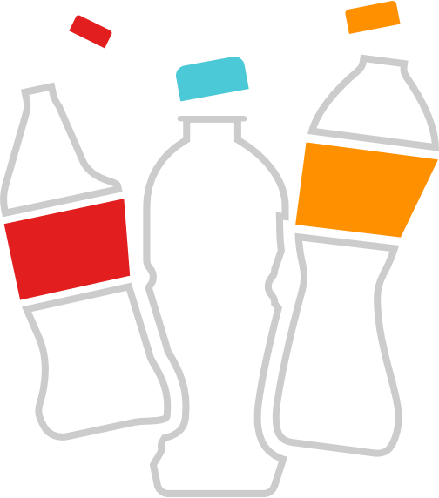







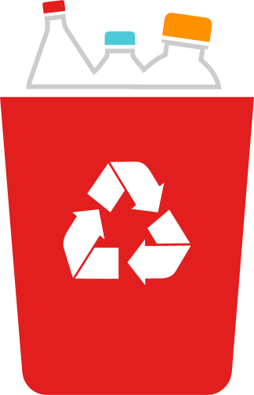
Life Cycle
Analysis
We use Life Cycle
Analysis to evaluate the environmental impact
of our products
Shrink with
recycled content
X
Virgin
-6% emissions
RPET
X
PET
-60% emissions
RPET
X
REFPET
Oil
-13% emissions
https://napcor.com/sustainability/life-cycle-analysis/
Comparative life cycle assessment of 12-cans packaging, 2022, Enciclo
Comparative Life Cycle Assessment: R-PET and RefPET, 2023, Enciclo

Slide 25


Carbon
Management
Valgroup measures
its carbon emissions automatically through emissions calculation software associated with its ERP.
Source: ghgprotocol.org

Slide 26
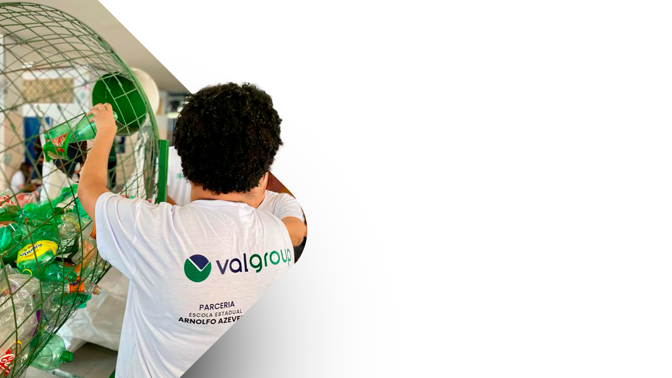






Social and Environmental
Projects
Established in 2023, with its pilot program
at the Arnolfo Azevedo School in Lorena/SP,
the project aims to promote awareness
about proper plastic disposal practices.
+123k
Bottles collected
+3ton
PET sent
for recycling
R$7k
Collected
for the School

Slide 27
THANK YOU
LARISSA OGERA D'OTAVIANO
@VALGROUPOFICIAL | @VALGROUP
Realização:

